Slide 1
Spelling Getting it write, wright, right!

Slide 2
Aims
To know the implications for spelling within the new primary curriculum
To understand how spelling is being taught in school and how this is changing
To have the opportunity to ask questions
To know how you can support spelling at home

Slide 3
Task
In a puiltacibon of teh New Scnieitst it siad you cuold jublme all teh letetrs in a wrod adn as lnog as teh frist adn lsat were the smae, reibadailty wolud hadrly be aftcfeed. My ansaylis did not cmoe to mcuh beucase of teh thoery at the tmie but raserceh sugsegts we may hvae smoe pofrweul palrlael prsooscers at wrok, which seepd up regnicoiton. We olny need the frist and lsat letetrs to spot chganes in meniang.

Slide 4
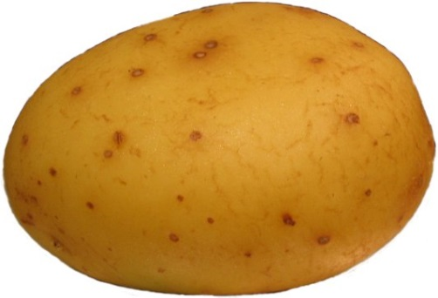
GHOWBTAPTEAU spells..?
GH OW BT A PT EAU
GH is P, as in hiccough
OW is O, as in bow
BT is T, as in doubt
A is A, as in acorn
PT is T, as in pterodactyl
EAU is O, as in beau

Slide 5
How have we been teaching spelling?
Diagnostic tests were carried out to ascertain levels
Weekly tests have taken place
Children’s progress has been tracked and adjustments have been made
Profile of spelling has been raised
Parents have been supporting children in learning spellings at home

Slide 6
New Curriculum Expectations
Significant increase in expectations across all year groups
Greater focus on spelling rules and conventions
Greater focus on word roots and origins
Word lists are particularly demanding
Skills need to be embedded

Slide 7
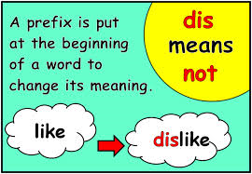
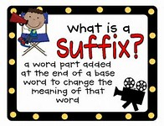
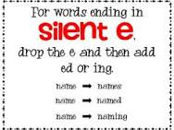
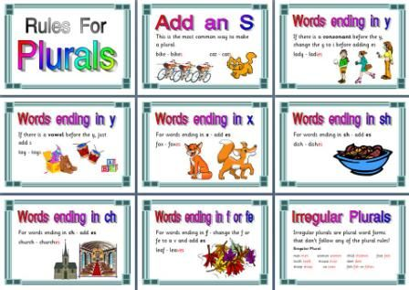
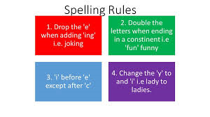
Rules and Patterns

Slide 8
Year 1 Expectations
In line with Phase 5 phonics
Words with alternate pronunciations of digraphs and trigraphs
Compound words – playground / blackbird
Adding endings – jump / jumper / jumping
Prefix – un : unkind / unfriendly
Common exception words ‘tricky words’ – school / friend / where

Slide 9
Year 2 Expectations
Rules:
Verb tenses : hope / hoped / hoping
Plurals : flashes / boxes
Changing adjectives to adverbs : quick – quickly / careful – carefully
Suffixes : happiness / joyful / payment / painless
Adding er & est

Slide 10
Year 3 & 4
Adding vowel suffixes to words with more than one syllable e.g. beginner
Suffixes: ation, ly, sure, ture, ous
Prefixes: un, dis, mis, re, sub, inter, super
disappear
although
guard
recent
knowledge
experience
business
accidentally
experience
reign

Slide 11
Year 5 & 6
Endings: tious, cious, cial, ance, ancy, ably, ibly,
Use of a hyphen
Homophones
Letter string – ough
Silent letters
pronunciation
prejudice
convenience
mischievous
nuisance
amateur
guarantee
parliament

Slide 12
What next?
Limitations to stand alone spelling tests:
-Children don’t always commit spellings learnt for a test to their long-term memory
-Some get 10/10 but then fail to spell these words correctly in their writing
-Gives teachers little information about the spelling skills children need to develop
New guidance from the government:
Higher emphasis on the teaching of spelling rules and strategies
50% of the marks in the end of Key Stage 1 & 2 SPAG tests are awarded to spelling questions

Slide 13
Changes to spelling
Each class will focus on a weekly rule / pattern and dedicated spelling time will take place every Friday
Children will bring home words which are linked to the pattern / rule they have been taught
Tests will take place the following week
Spelling will feature more heavily in daily literacy sessions
Children will be given further opportunities to self correct spelling through dictionaries

Slide 14
Will this involve all children?
Children who are currently working below the expected level for their year group will take part in spellings interventions looking at words which are more appropriate for them
All other children will look at rules for their year group, we will differentiate through breadth of words following the same rules
e.g. tion:
nation
relation
recommendation

Slide 15
How can you help?
Sounding out by breaking the word into phonemes
Look, cover, write, check
Split the word into syllables – re-mem-ber
Mnemonics e.g. People Eat Orange Peel Like Elephants or OU Lucky Duck (would/could/should)
Identify words within words e.g. rat in separate
Making links with word meaning e.g. sign – signal – signature
Dictionary skills

Slide 16
How can you help?
Websites: Topmarks & Woodlands Junior – spelling games
Familiarise yourself with the statutory words for each year group
Encourage your child to ‘have a go’
Remember – it is fine to make mistakes, it is important that children given the skills of how to correct them
Any Questions?

